Slide 1
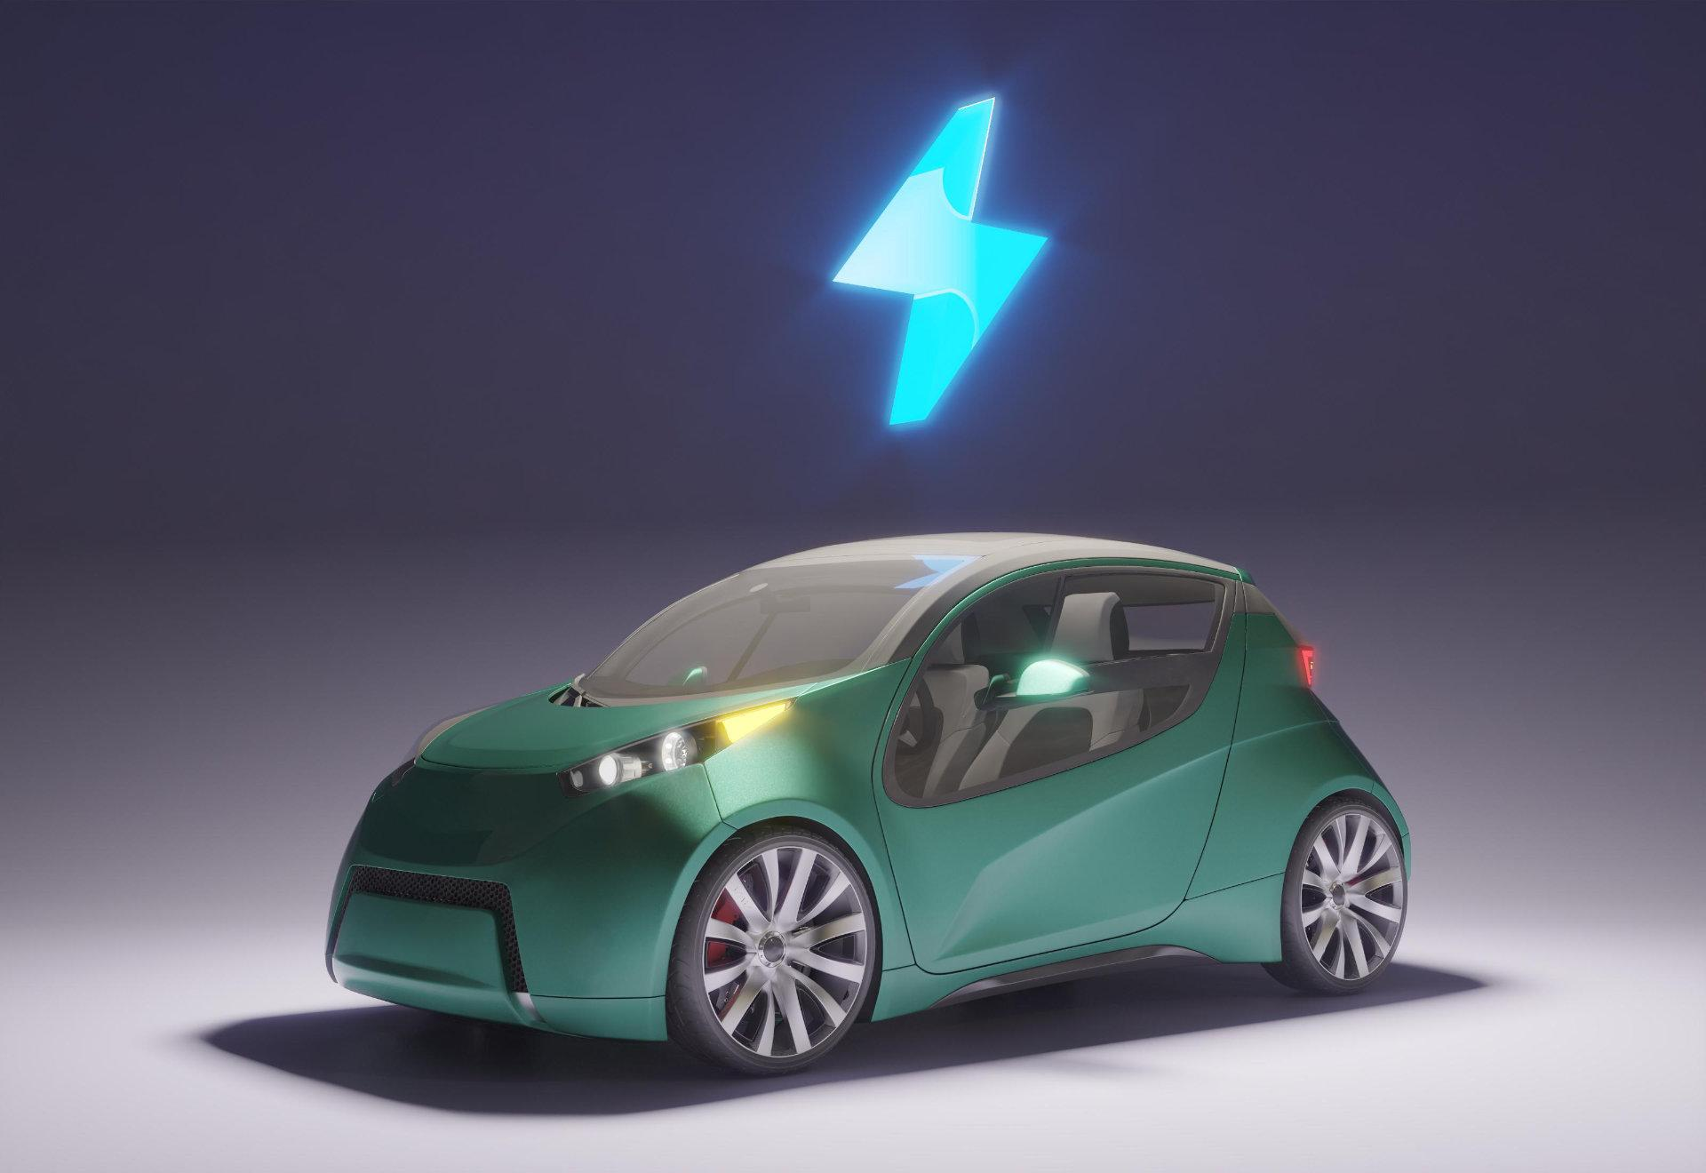
POOL RIDES
ty
Team: WILL CODE 4 FOOD
Notes:
Current Presenter: Jonathan Jakab
Hello Everyone, and thank you for joining us today.
My name is Jonathan, and my team members are Enrique, Steven, Mickey, Mariya, and Kurtis, and we are the developers that bring you PoolRides.
==NEXT SLIDE==

Slide 2
TABLE OF CONTENTS
01
02
03
04
05
06
07
08
Presenter: Jonathan Jakab
ABOUT THE PROJECT
PROJECT GOALS
SOFTWARE
REQUIREMENTS
PRODUCT
DEMO
TECHNOLOGIES
& ARCHITECTURE
TESTING
DEPLOYMENT
CLOSING
STATEMENTS
Notes:
Current Presenter: Jonathan Jakab
We here at Will Code 4 Food have teamed up with the CEO of Pool Rides Isaiah Cole to help create an app like nothing on the market currently and today we would like to show you what we've been working on and what the future holds for the ride sharing space.
Today, we will be discussing the goals that were set out with Pool Rides and how have gone about accomplishing them. We will talk about the steps we took in developing this service, the technologies we used, our testing and the results, the deployment of the app, and lasting what we as a group have learned from this opportunity.
==NEXT SLIDE==

Slide 3

ABOUT THE PROJECT
Presenter: Jonathan Jakab
Mission: Reshaping how the world moves and comes together in a Universal Network.
The Problem.
What is Pool Rides?
Solving the Problem.
DIVE INTO THE NEW WAVE OF ON-DEMAND TRANSPORTATION INSTA-TRANSIT!
Notes:
Current Presenter: Jonathan Jakab
So let us begin.
What is PoolRides? PoolRides is setting itself up to be the next pioneer in the ride sharing space known as insta-transit. Think of the Web 3.0 of the ride sharing space. For many years now we’ve had giants such as Uber and Lyft dominating the mobility space and for many years we’ve heard users concerns about who they were riding with, as well as a strong dislike of interacting with drivers. A so called Shut-up and Drive or Don’t Talk to Me environment. This idea is only further reinforced by features such as quiet mode now found on Uber.
==NEXT SLIDE==

Slide 4
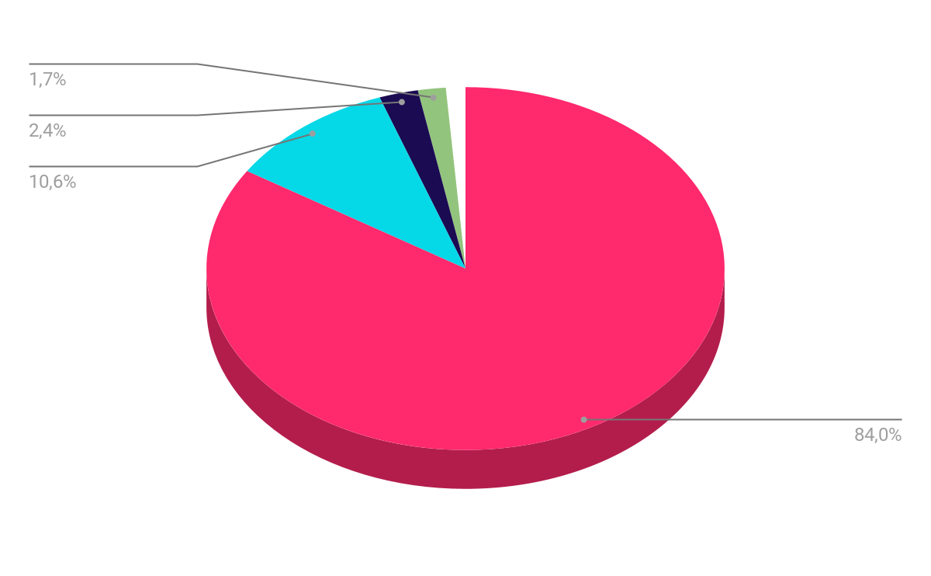
UBER RIDE PREFERENCE
Presenter: Jonathan Jakab
SILENT RIDES
484 PARTICIPANTS
STAND-UP RIDES
61 PARTICIPANTS
RUDE RIDES
14 PARTICIPANTS
THERAPY RIDES
10 PARTICIPANTS
OTHER RIDES
7 PARTICIPANTS
TOTAL
576 PARTICIPANTS
TPG POLL OF 576 OF ITS USERS.
Notes:
Current Presenter: Jonathan Jakab
We can see that many users of Uber do infact express this concern as in a 2019 poll by TPG, a random group of 576 online users were asked what there ride preferences were while using Uber. Roughly 84% of participants demonstrated a strong preference towards silent Uber ride while only 10% prefered stand-up comedy and less they 3% prefered any of the other categories. While this can be attributed to a multitude of factors, more often than not it was due to the users not wanting to interact with their drivers either due to not knowing enough about the individual, or not feeling comfortable in communicating with them.
And it is this awkwardness of sitting in a vehicle with a complete stranger you know nothing about that that PoolRides has set out to fix.
==NEXT SLIDE==

Slide 5
ABOUT THE PROJECT
Presenter: Jonathan Jakab
Mission: Reshaping how the world moves and comes together in a Universal Network.
The Problem.
What is Pool Rides?
Solving the Problem.
DIVE INTO THE NEW WAVE OF ON-DEMAND TRANSPORTATION INSTA-TRANSIT!
Notes:
Current Presenter: Jonathan Jakab
You see, with Pool Rides adoption, gone will be the days that you sit in a car with someone you know nothing about. By using advanced artificial intelligence, PoolRides algorithms will be able to recommend and pair its users with the best fit driver for them. A driver that is not only is close to them and can get to them in a timely manner, but one that also shares similar interest with the user. Whether that be Music, Hobbies, Books, and so on. That way when you get in that car, you’ll know enough about your driver to not only feel safer but also more comfortable in communicating with them.
You see, Pool Rides doesn't just want to be another platform to help get you from Point A to Point B. Pool Rides wants every trip to be enjoyable, safe, and for you the user to have a good time getting to your destination. And that’s why Pool rides is setting itself up to be the next step in the ride sharing space called insta-transit.
I will now hand it off to Enrique who will talk to you about the Goals of the project.
==NEXT SLIDE==

Slide 6

02
PROJECT GOALS
Notes:
Current Presenter:
Enrique Alvarez
Hello everyone, my name is Enrique and I too am part of the development team working on the Pool Rides application.
==NEXT SLIDE==

Slide 7
The Solution
Presenter: Enrique Alvarez Gonzalez
Algorithm based matching on distance and general interests/music taste in mind
Flat rate pricing per mile (no surging or extra fees)
Drivers pay a monthly fee to stay on the platform to continue giving rides
All the fare of every trip goes to the driver
Notes:
Current Presenter:
Enrique Alvarez
While there are other ridesharing apps, at poolrides they are doing a few things to make Poolrides the service both riders and drivers want to use
We match riders and drivers based on their conversational and music interests to ensure that you have a comfortable ride
Another unique aspect of poolrides is the monetization model and how different it is from the competitors. Other apps can really rake you over the coals with surge pricing like when you leave a busy sporting event and many people are trying
to get a ride share. But at poolrides it is always a flat per mile fee no matter how busy. This way the rider always knows what to expect when they need to get from point a to point b
As for the drivers, other companies take a cut of every single fare from a driver. At poolrides everything from a fare goes to the driver After all, the driver does all the work.
All they have to do is pay a flat monthly fee to gain access to the platform and customers.
==NEXT SLIDE==

Slide 8
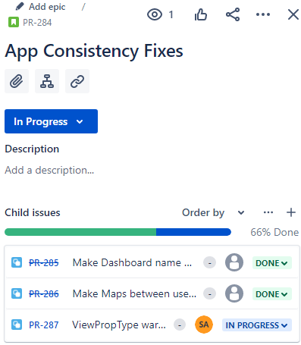
Agile Strategies
At the start of each sprint, we met and broke down stories into sub tasks
which would be assigned to members
Take the feedback from our client at the end of the sprints
Prioritized our backlog in order of importance
Must finish, or ok if we didn’t get to
Estimate work left to be done
Notes:
Current Presenter:
Enrique Alvarez
For most of our sprints, we would meet at the start and plan out what everyone would do. In these meetings we would estimate how long tasks would take, prioritize our backlog, and decide if somethings are must-do’s or optional based off of feedback that we would get from our client at the end of our sprints.

Slide 9
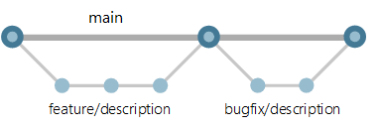
Git Workflow Strategy
Presenter: Enrique Alvarez Gonzalez
Start of Sprint we create a feature branch per story
Once finished, create a pull request back into main
Team member reviews the PR. If good, merges into main.
Notes:
As for our workflow strategy for github, we decided to make liberal use of branches from the start of our development in 190. At the start of each sprint when we decided who would work on what tasks, each person would make a feature branch in github where they would be able to commit their work as they go without worrying about merge conflicts. After the task was finished, A pull request was made and someone who didn’t work on that branch would review. If it looked good and passed testing it was merged into main and that branch was pruned. For bugs that were more complex than a simple alignment or calculation error, a branch was made and we followed the branch, request, and merge model.

Slide 10
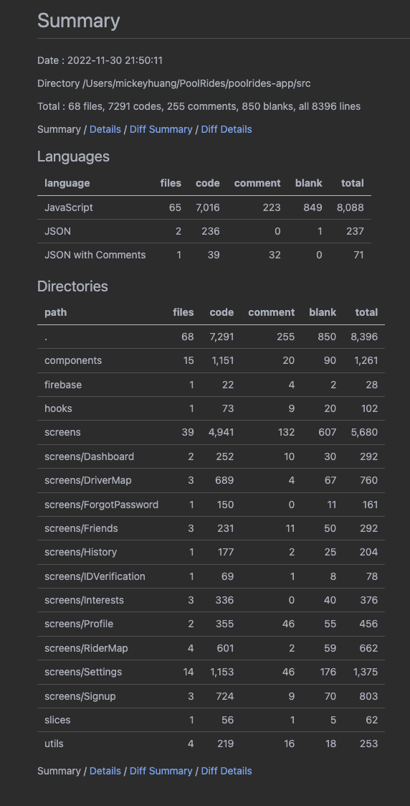
Work Quantified
Presenter: Enrique Alvarez Gonzalez
9000+ lines of code (with backend code)
69 files.
500+ hours spent on the project.
12.5 Energy drinks consumed.
0 Broken keyboards or monitors.
20+ Long nights
Notes:
Steven is next

Slide 11
03
SOFTWARE REQUIREMENTS
Notes:
Current Presenter:
Steven Aguirre
Hello everyone, My name is Steven and I will be going over the software requirements that the team has implemented and will implement in the future.

Slide 12
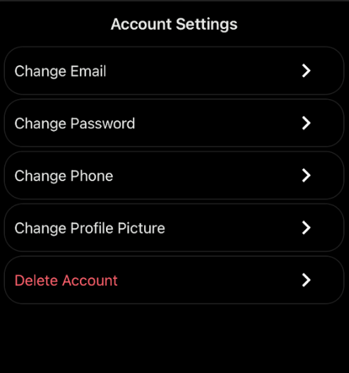
Software Requirements
Presenter: Steven Aguirre
Login Requirements:
Application Functionality:
Change Email
Change Password
Change Phone
Change Profile Picture
Delete Account
User can edit general interests after account creation
SignUp
Password requirements:
8 characters, 1 lower case, 1 upper case, 1 symbol
Firebase Firestore
Used to store User and
Ride Information
Firebase Storage
Used to store profile pictures and driver licenses
Firebase Authentication
User passwords are verified via a token based authentication system
Passwords are hashed with scrypt
Notes:
Current Presenter:
Steven Aguirre
Hello everyone my name is Steven and I'm going to be talking about the software requirements involved with this project. When the user first makes an account, their password must be 8 characters long have 1 upper case and lower case and 1 symbol. The password is then passed to Firebase Firestore where it is verified via a token based authentication system.
Once the user's account is successfully created and verified, they are able to change a couple things in their account including their email and password. To verify the change, the user is given an email to verify that they were the ones that made the request.
== PAGE BREAK ==

Slide 13
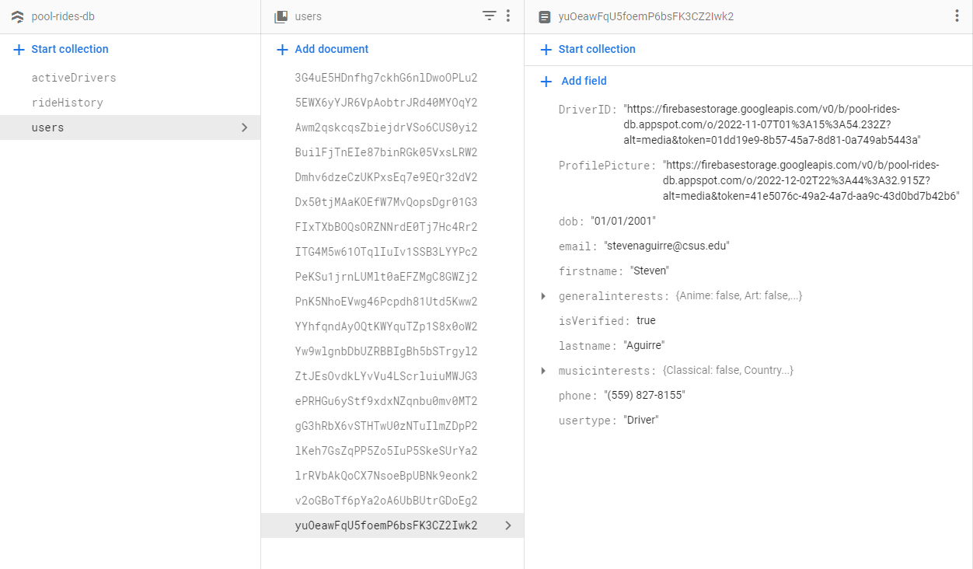
Google Firebase Firestore
Presenter: Steven Aguirre
Data Stored In Document Style (NoSQL)
General User Data:
First and Last Name
Date of Birth
Phone Number
Email
UserType: “Rider” or “Driver”
General/Music Interests
Profile Picture (optional)
Driver Data:
Driver’s License upload
isVerified
Notes:
Current Presenter:
Steven Aguirre
In Firebase Firestore, we store a range of information in a document which we can later call whenever necessary. For all users, we save a users name, date of birth, phone number, email, user type, and interests. Drivers also have their driver's license uploaded to Firebase Storage, which can be accessed via URL.

Slide 14
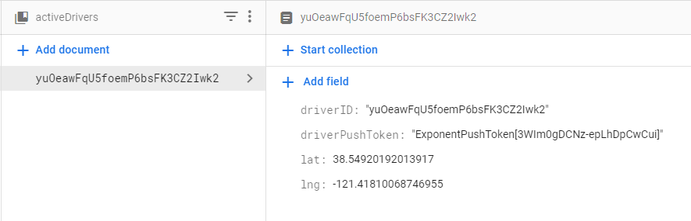
Presenter: Steven Aguirre
The Ride Process
Driver Flow:
Driver clicks the Go Online button on the dashboard.
A new document is created in the database under activeDrivers that contains the driver’s coordinates along with their push token and driverID.
Driver waits for available rides and is given an option to accept.
If accepted, the rider’s pick-up location and destination are shown on the driver map.
Once the rider is taken to their destination, the ride is complete and recorded in the rideHistory document.
Rider Flow:
Rider selections pick-up location and destination.
Rider selects between ride options
Rider makes payment (Payment not currently implemented).
Once a driver is found, their name and interests appear on the rider map.
Once the rider is taken to their destination, the ride is complete and recorded in the rideHistory document.
Notes:
Current Presenter:
Steven Aguirre
==NEXT SLIDE==

Slide 15
DEMO
DEMO OF APP
Notes:
Current Presenter:
Mickey Huang

Slide 16
First Half Demo:
https://www.youtube.com/watch?v=WGfmSk0IiR4
Second Half Demo:
https://www.youtube.com/watch?v=M7fpaJIYS-o
Notes:
Current Presenter:
Mickey Huang

Slide 17
05
TECHNOLOGIES
AND ARCHITECTURE
Notes:
Current Presenter:
Mickey Huang

Slide 18
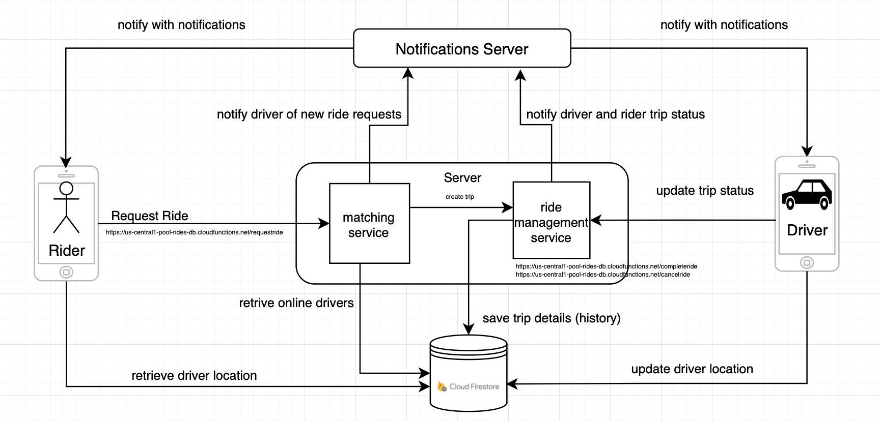
High Level Architecture
Presenter: Mickey Huang
Notes:
Current Presenter:
Mickey Huang

Slide 19







Technologies
Presenter: Mickey Huang
FRONT END
Third Party API’S
React Native with Expo framework -
Axios JS Library -
CSS -
Validator.js -
Various community OS RN libraries -
Yarn -
- Google Places Autocomplete
- Google Distance Matrix API
- Google Directions API
BACK END SERVER
DATABASE
NodeJS -
Firebase Cloud Functions-
- Firebase Firestore
- Firebase Auth
- Firebase Storage
Notes:
Current Presenter:
Mickey Huang
QUEUE FOR NEXT SLIDE: “So these are some of the technologies we are using, now I will go over the cost estimate”

Slide 20
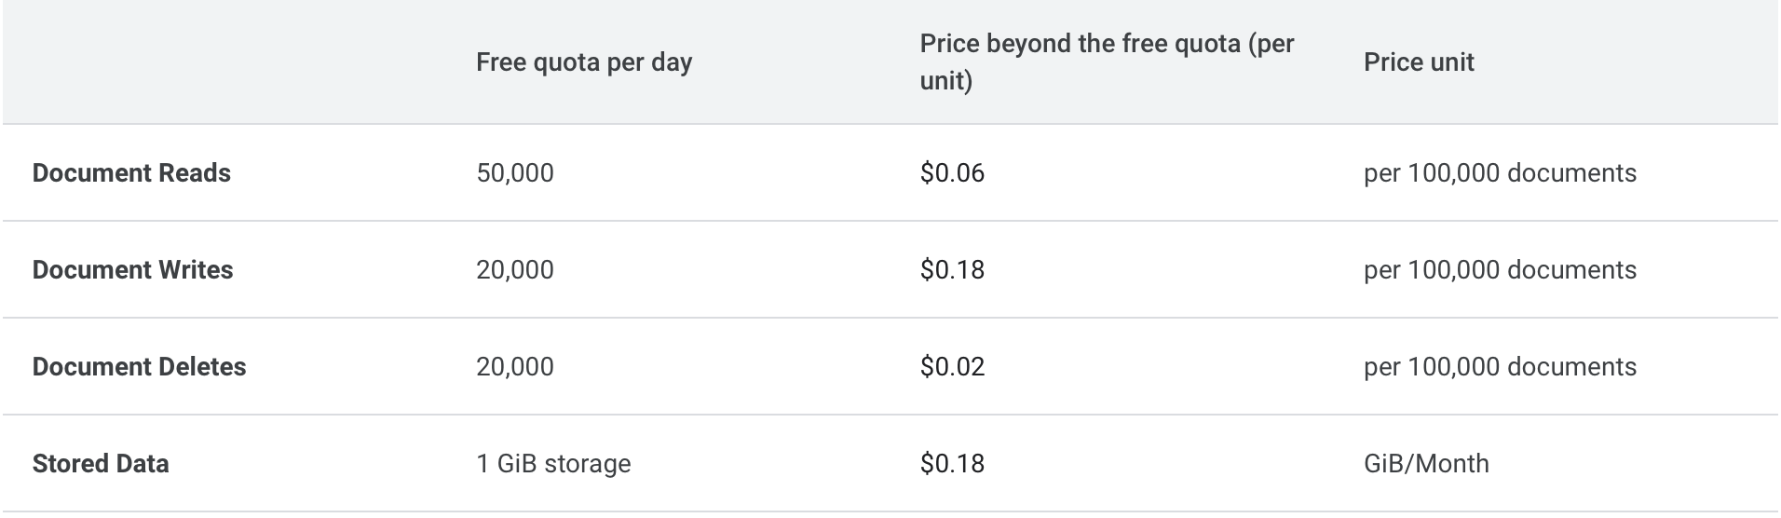
Cost Estimate (Page 1/2)
Presenter: Mickey Huang
Notes:
Current Presenter:
Mickey Huang
QUEUE FOR NEXT SLIDE: “Now that I have gone over the costs of the Firebase Firestore I will try to estimate this with one of our core function which is Ride Request”

Slide 21
Cost Estimate (Page 2/2)
Presenter: Mickey Huang
Request Ride and Matching Process:
3 writes ride status (searching, in-ride, accept, complete ride)
2 writes for updating information to ride document (send rider geolocation, rider id, driver id)
2 reads (getting active drivers and their activity status)
MATH:
500,000 * 5 writes = 2,500,000 writes - 600,000 free writes = 1,900,000 writes / 100,000 = 19 * 0.18 = $3.42
500,000 * 2 reads = 1,000,000 reads - 1,500,000 free reads = free
In - Ride Process: 30 minutes * 5 seconds = 1,800 seconds
1 write/5s to update geolocation of driver until ride completes
MATH: 360 writes * 500,000 = 180,000,000 / 100,000 = 1800 * 0.18 = $324
1 read/5s to update geolocation of driver to rider map
MATH: 1800 * 0.06 = $108
Total monthly cost = $3.42 + $2.10 + $324 + $108 = $435.42
There are other costs such as Google Maps Platform and Firebase Cloud Functions Invocations*
Notes:
Current Presenter:
Mickey Huang
QUEUE FOR NEXT SLIDE: “The total monthly cost is 437.52 for one of our core functions, so now that I have gone over a sample of our cost estimate I will quickly go over our github page and github commit tree”

Slide 22
06
TESTING
Notes:
Current Presenter:
Mariya Cherednichenko
Hello everyone. I will be going over the testing.
==NEXT SLIDE==

Slide 23
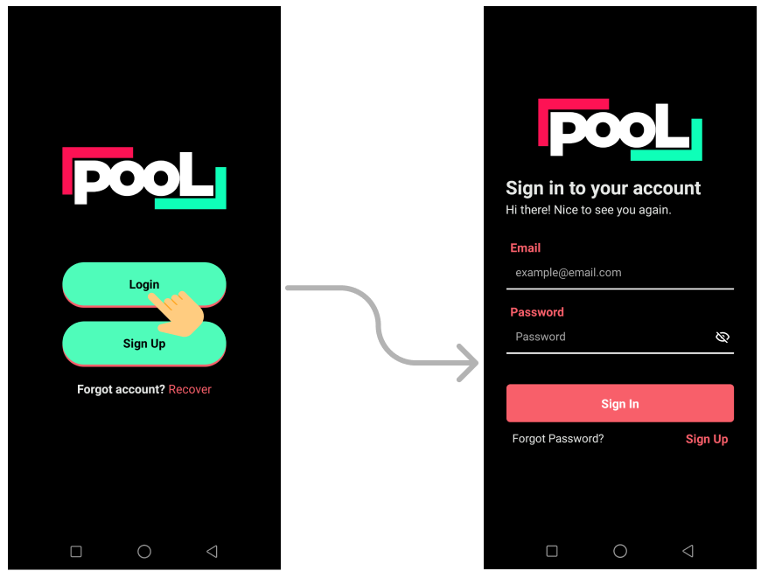
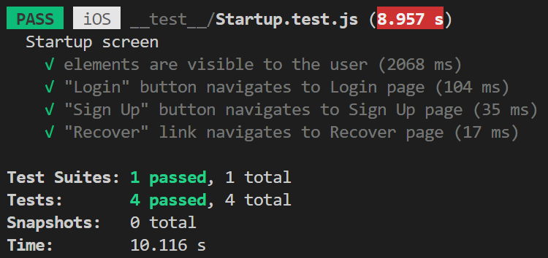
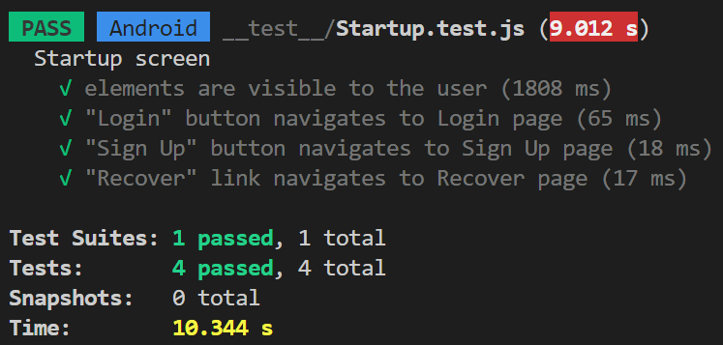



Functional Testing
Presenter: Mariya Cherednichenko
Tested it manually
Tested with Jest and React Native Testing Libraries
Tested on iOS and Android
Notes:
Current Presenter:
Mariya Cherednichenko
For the functional testing, we tested our app manually and we also used Jest with React Native Testing Libraries to test on iOS and Android. Our goal for the functional testing was to ensure that all user interactions with the app worked as intended. We tried to test as many user interactions as possible. On this slide you can see one example of the functional tests we did, where we tested to make sure all the buttons navigated to the correct pages. On the right-hand side, you can see the test results for iOS and Android.
==NEXT SLIDE==

Slide 24
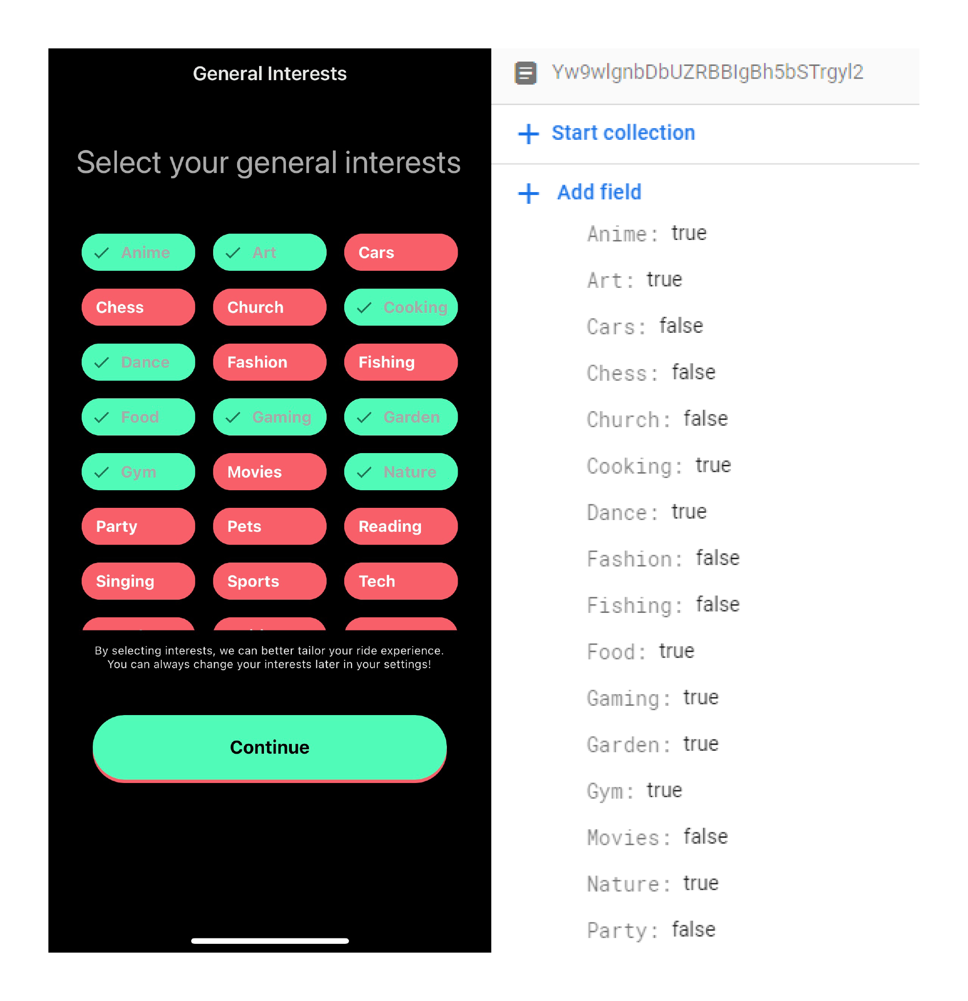
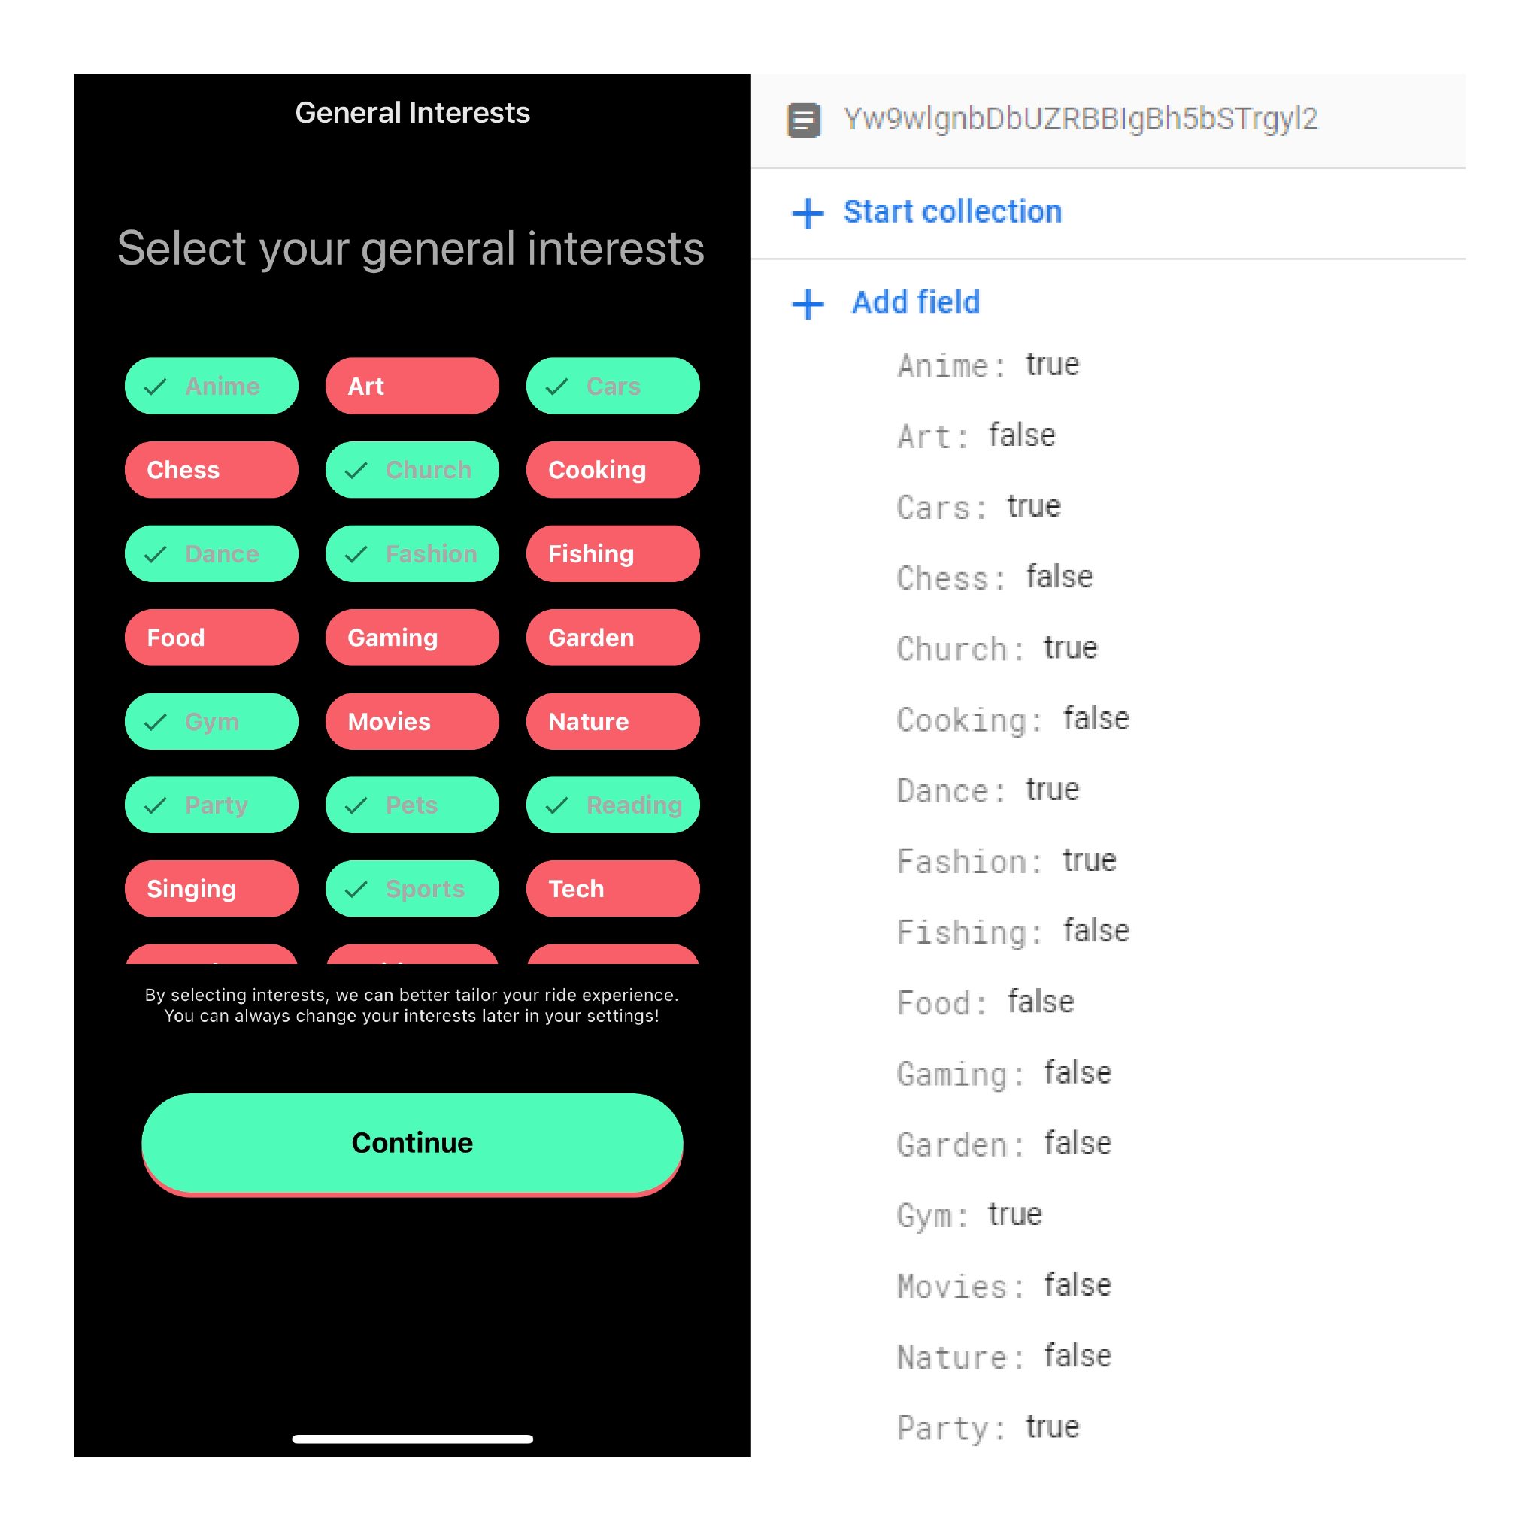
Unit Testing
Presenter: Mariya Cherednichenko
Before the updates
After the updates
Tested our database manually
Our goal was to make sure data is sent to a database when users signs up and the data is accurate.
When user updates information in the profile page it is reflected in the database.
For the backend server functions we used postman tool to call our rest api endpoints.
Integration Testing
Tested it manually by using the app and making sure everything works well together.
Notes:
Current Presenter:
Mariya Cherednichenko
For our unit testing, we tested our database manually. We were running out of time and realized we would need a lot of valid emails in order to do unit testing for our database, so we decided to test manually. Our goal for the database testing was to make sure that when a user signs up, the data goes into a database and is accurate. When a user updates profile information or deletes the account, it should also be reflected in the database. On this slide, you can see one example of the tests we did. We tested to make sure that when a user updates interests in their profile, they are also updated in the database. So, we compared the values before and after the update to see if the interests in the profile page match the interests in the database. For our backend server functions, we used the Postman tool to test it with. We used it to call our REST API endpoints. For the integration testing, we tested it manually by using our app, as you have seen in the demo. We made sure that everything works well together. That's pretty much it for testing, so I am going to pass it to Kurtis.
==NEXT SLIDE==

Slide 25
07
DEPLOYMENT
Notes:
Current Presenter:
Kurtis Tran
Hello everyone, My name is Kurtis and I will be going over the development process of PoolRides.
==NEXT SLIDE==

Slide 26
Deployment
Presenter: Kurtis Tran
Client did not want us to deploy to the app store because
He wanted to give the source code to his developers to expand on it before release
IP rights
Instead we deployed to the Expo Go app
allows us to privately build and run the app on iOS and Android
We also provided documentation from Expo to our client when he decides to deploy to the App Store. Expo Documentation link
Notes:
Current Presenter:
Kurtis Tran

Slide 27
08
CLOSING STATEMENTS
Notes:
Current Presenter:
Kurtis Tran

Slide 28

CLOSING STATEMENTS
Presenter: Kurtis Tran
Client’s feedback
Aesthetic + minimalistic user interface
Matchmaking for rider and driver
Great progress/foundation for what he envisioned for his upcoming app
Notes:
Current Presenter:
Kurtis Tran

Slide 29
Lessons Learned
Presenter: Kurtis Tran
Things we learned in this class
Insights/wisdom that our team would like share with the class
New technologies & tools:
Javascript
React, React Native
NodeJS
Yarn
Expo
Firebase
Google APIs
Soft Skills:
Teamwork
Time management
Client management
SCRUM:
Prepared for sprints as soon as possible
Reusable code/components
Scope of each story
Communicated with advisor and client about time restrictions and core features needed to be implemented
Notes:
Current Presenter:
Kurtis Tran

Slide 30
“”
— Ralph Waldo Emerson
““It’s not the Destination, It’s the Journey.””
Notes:
Current Presenter:
Kurtis Tran

Slide 31
Q&A
Notes:
Current Presenter:
We will now be accepting questions.

